Slide 1
Hand Gesture application
Group Members: Jared Wolf, Trenton Robichaux, Kyle Gobert, Robert Aucoin
Instructor: Dr. Xiaoming Liu

Slide 2
Development
Developed entirely in Python
OpenCV library is the primary library required
Hand detection is based on Haar-Like features, i.e. comparing a large set of “positive” images to an even larger set of “negative” objects
This application uses a trained hand Haar Cascade Classifier: An XML file that is created after comparing the sets of positive and negative images
This application uses that Cascade Classifier to check for similar features in a webcam frame
Source of the Cascade Classifier: https://github.com/Aravindlivewire/Opencv/blob/master/haarcascade/aGest.xml

Slide 3
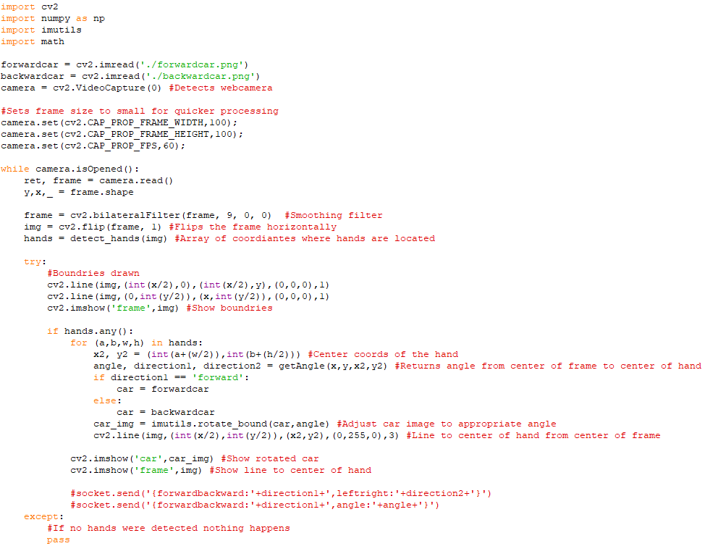

Slide 4
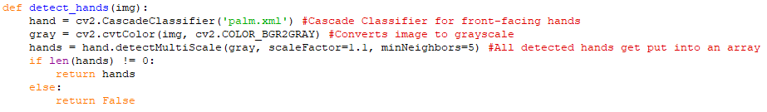
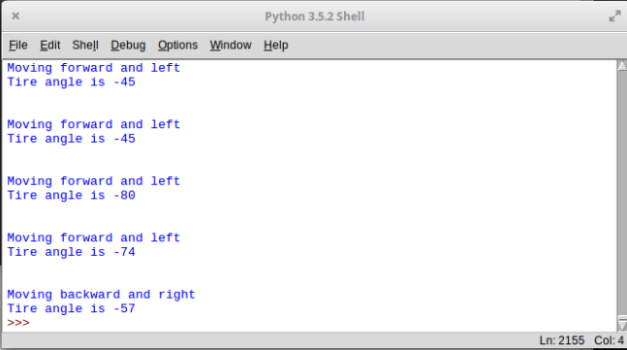

Slide 5
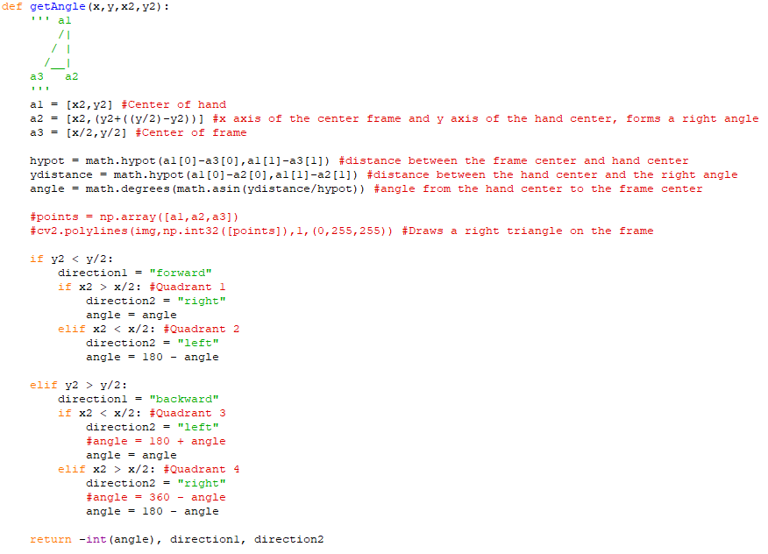
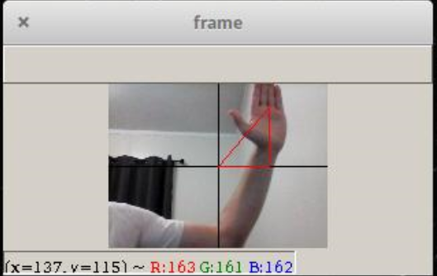

Slide 7
Integration and Testing
Requirements for this application:
Python 3.5 or higher
Minimum 4gb of RAM
Application tested on Linux Elementary OS and Windows 10
Accomplishments:
Hands can be detected
“Almost” any environment works
Output of car movement
Works with children

Slide 8
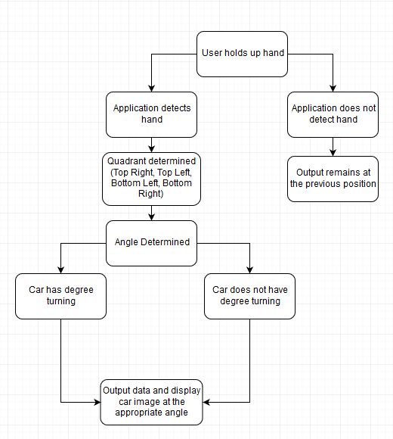

Slide 9
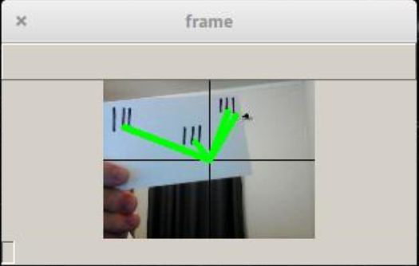
Test Analysis
“Phantom Hands”
Issues arise when:
Lighting is poor
Background is noisy (Background movement)
“Phantom hands” are detected
Additional issues:
Requires fingers to be together
Choppy on low-end computers with background applications
May not integrate well with RaspberryPi car
Does not currently work with Socket

Slide 10
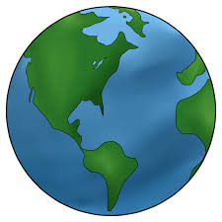
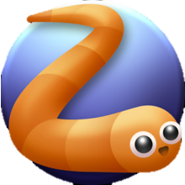

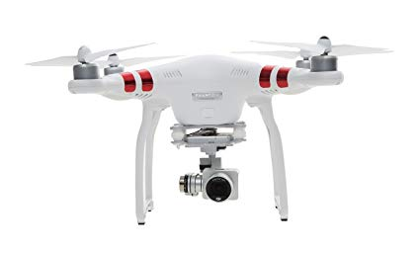
Implementation
Real-World Scenario
Steering remote-controlled vehicles
Simple games
Controlling drones

Slide 11
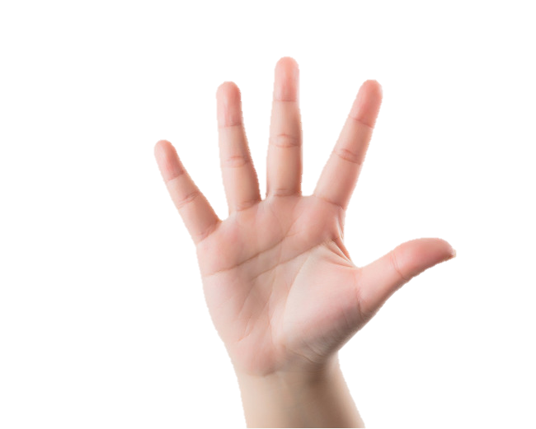
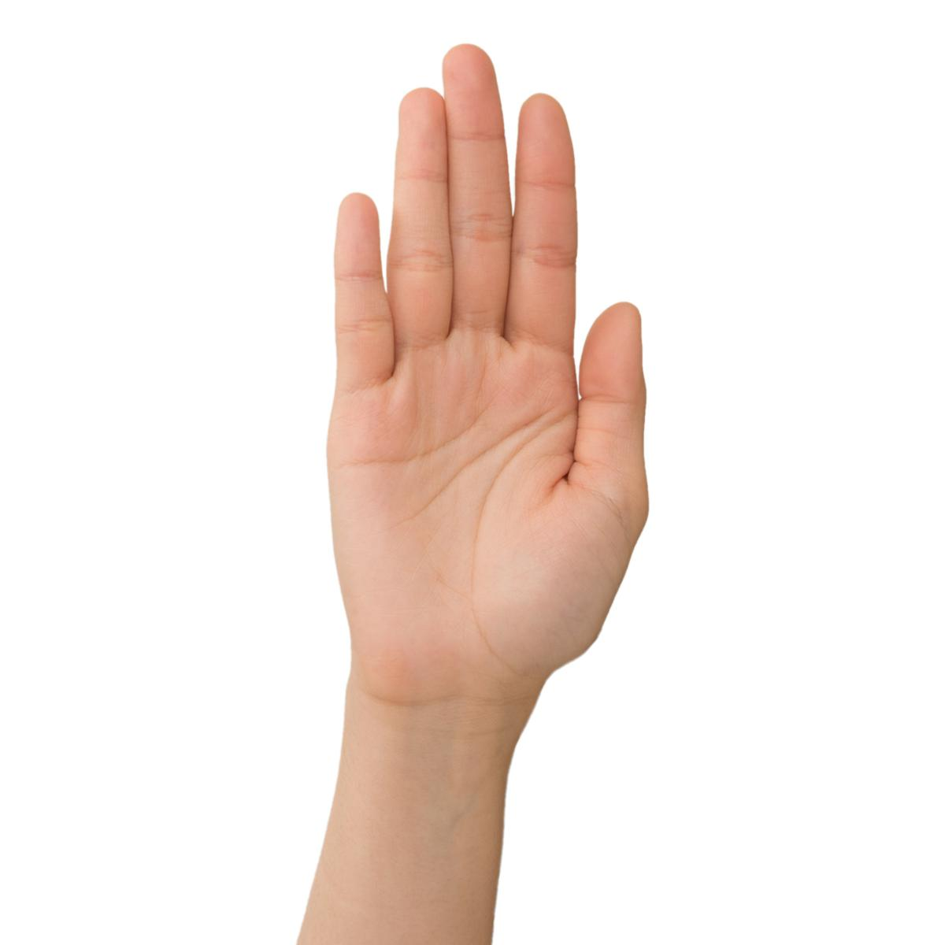
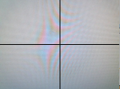
Problems in earlier phases
Previous Version
Background Movement / Lighting Difficulties
Finger detection
New Version
More precise turning
Palm detection
Grid layout

Slide 12
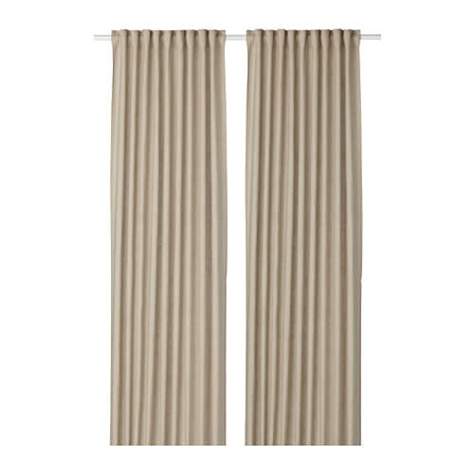
Resolution of Problems
Phantom hand
The issues identified are not avoidable, but can be mitigated by:
Ensuring the environment being used has adequate lighting
The camera is facing a blank wall where no one will be walking by
Making sure nothing in the background will cause “phantom hands”, i.e. curtain folds
Running the application on a computer with sufficient processing power and memory
Additionally:
There will have to be a short training period to teach the users that they must keep their fingers together in order for the application to work
Issues regarding the integration with socket server and the RaspberryPi car will be resolved in future development

Slide 13
Evaluation and Future Work
Design:
Current design allows for closed finger hand detection
Car control based on position of the hand in a coordinate plane
Output consists of movement data and an image of a car in the appropriate position for the user
Development:
Developed solely in Python 3.5
Requires the use of OpenCV library for Python
Uses Haar-Like features for object detection

Slide 14
Evaluation and Future Work
Integration:
Since everything is written in Python, integration will be simple
Requires that the computer running the application install the library “opencv-python”
Will require more development to work with control team’s socket server
Will also require more development to integrate with the Raspberry Pi Car
Testing:
Successfully tested on Linux and Windows
Works only with Python 3.5+
Wasn’t tested on Mac, but should work as long as Python 3.5+ is on the computer

Slide 15
Evaluation and Future Work
Implementation:
When fully integrated it will allow users to control an RC car completely with their hand
Will be able to be used in a variety of environments
Future Work:
Include speed with the hand movements, i.e. The farther away from the center of the frame the hand is, the faster the car will go
Change the output of movement data to work with the control team
Change the movement data to work with the RaspberryPi car, i.e. if it uses degree turning or if turning is simply “left” or “right”

